Slide 1
Final project
Cacciatore Davide - 2015641
Ghinassi Arturo - 1863151
Savarese Camilla - 1838890

Slide 2
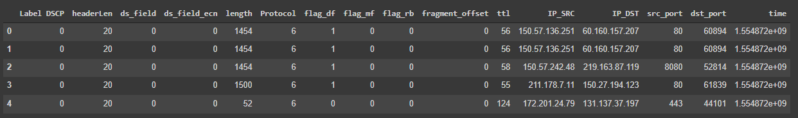
Dataset
We used the dataset provided by the MAWI project, in which the amount of the trace is equal to 5 mln of packets retrieved from the traffic trace of 10/04/2019.
We splitted the entire trace in sub-portions of 1 million each, then we chose one of them and extracted only the IP packets, for a total of 869802 packets.

Slide 3
Part A

Slide 4
General info from the trace using capinfos
File encapsulation | Ethernet
File timestamp precision | microseconds (6)
Packet size limit | 34 bytes - 96 bytes
Number of packets | 1 Mln
File size | 98 MB
Data size | 1179 MB

Slide 5
General info from the trace using capinfos
Capture duration | 3,642794 seconds
First packet time | 2019-04-10 07:00:13,970837
Last packet time | 2019-04-10 07:00:17,613631
Data bit rate | 2589 Mbps
Average packet size | 1179,13 bytes
Average packet rate | 274 kpacket/s
Strict time order | False

Slide 6
Time evaluation
The time evaluation has been performed on an Intel i5-8265U CPU @ 1.60GHz 1.80 GHz and RAM 8GB
Sequential reading
Parallel reading
2687 seconds = 45 minutes
Sub-portions of 250000 packets
Loaded in 4 different steps
1283 seconds = 22 minutes
Sub-portions of 50000 packets
20 different jobs

Slide 7
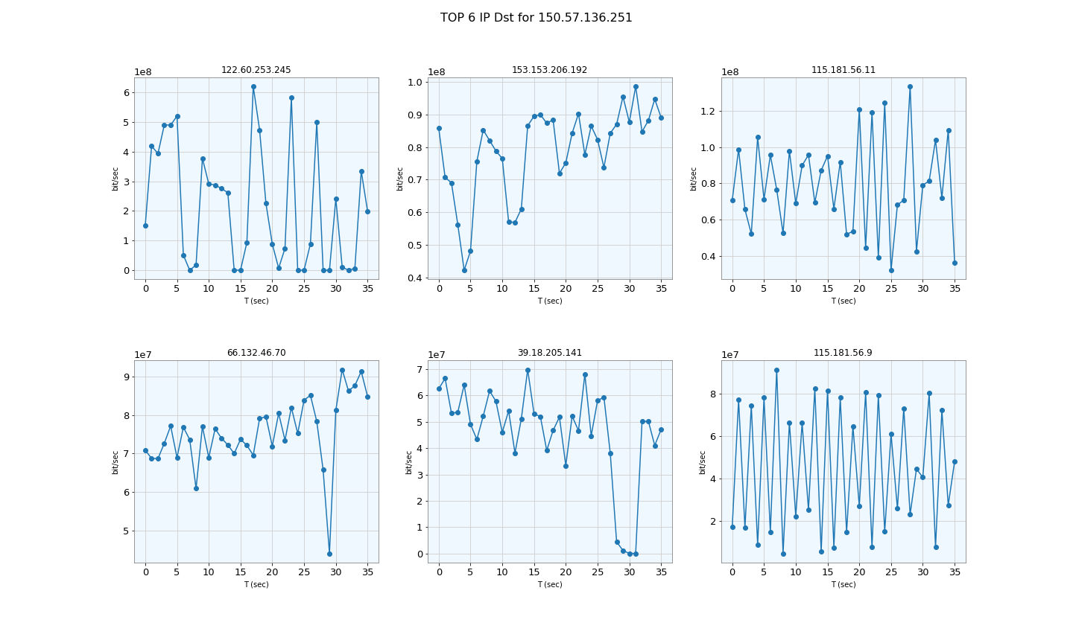
IP which generates the highest amount as sender traffic
Bitrate of 6 IP addresses mostly used as endpoint by 150.57.136.251

Slide 8
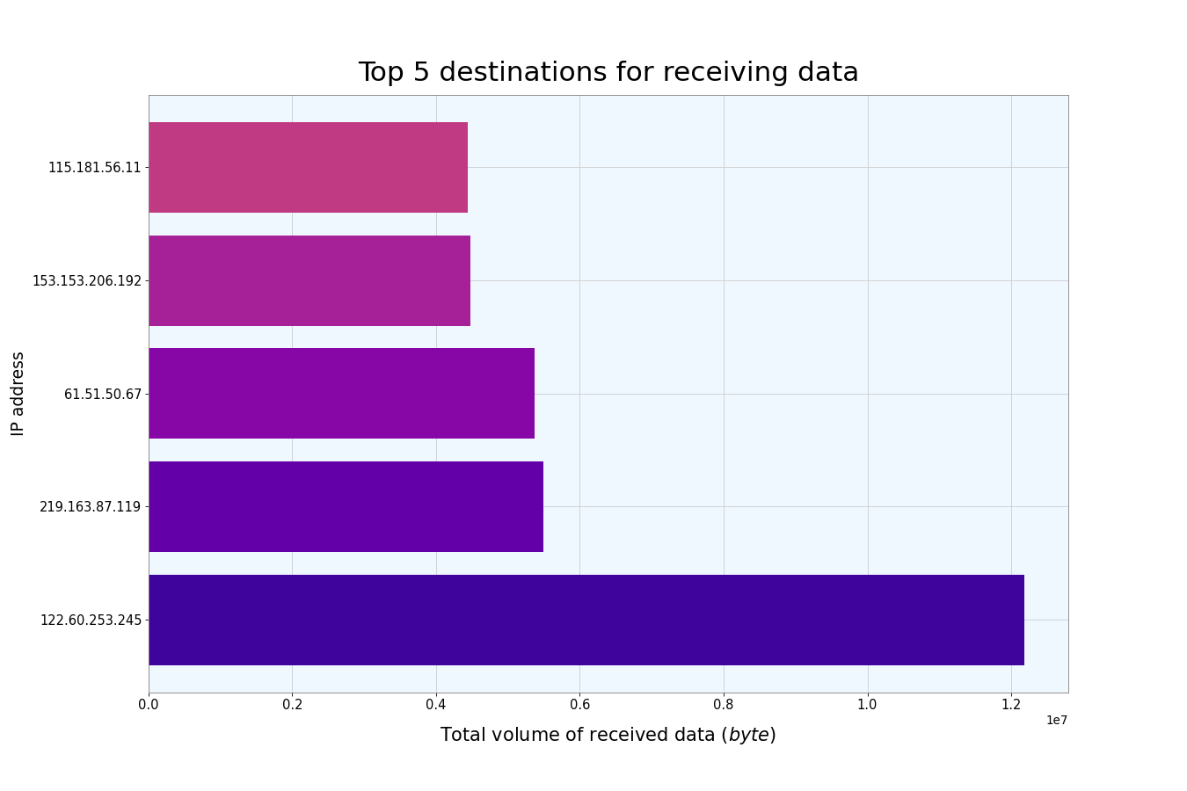
Top 5 destination IP (received bytes)

Slide 9
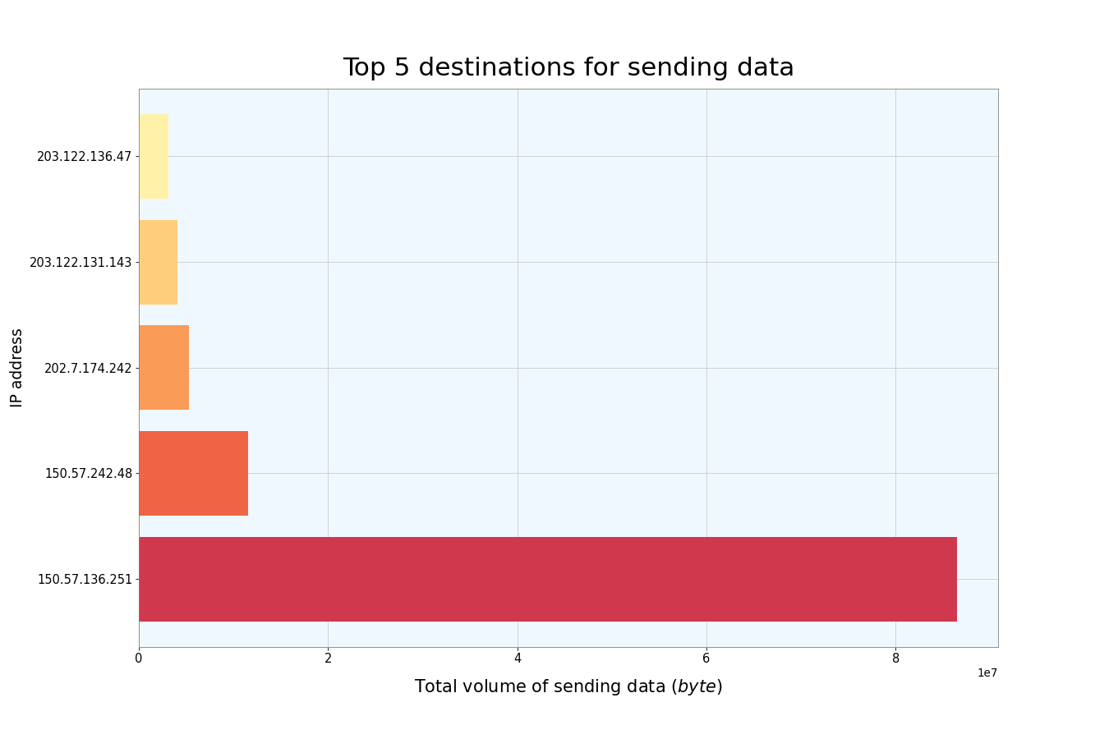
Top 5 source IP (sent bytes)

Slide 10
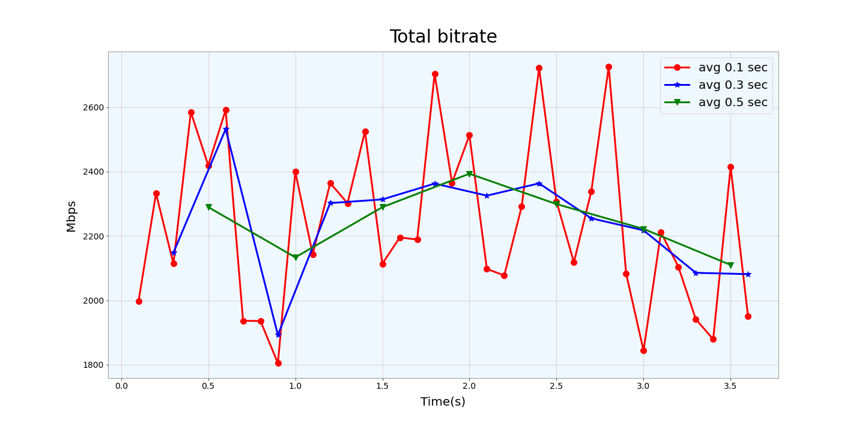
Evaluation of the BitRate considering all the trace with 3 different sampling rate

Slide 11
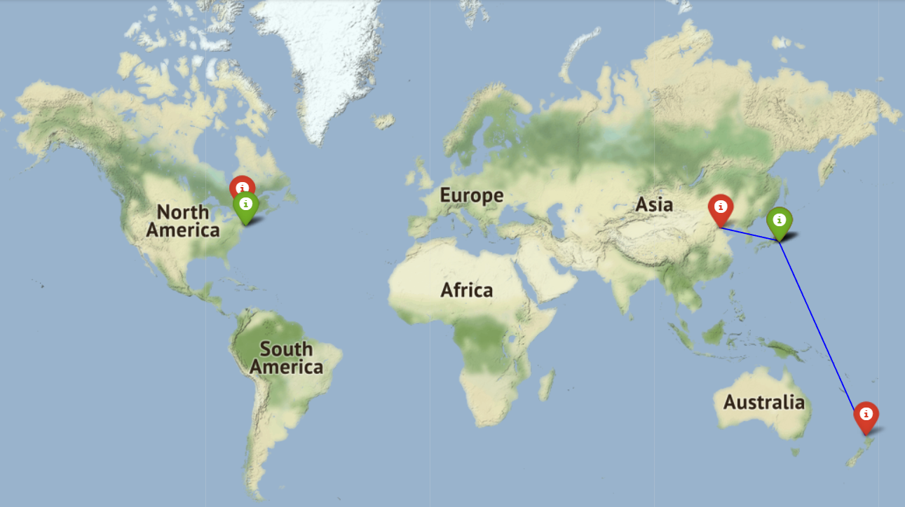
GeoLocal referenciation of the 5 session with the highest amount of traffic generated
Session | Source | Destination
1 | New York | Ontario
2 | Tokyo | Auckland
3 | New York | Ontario
4 | Tokyo | Tokyo
5 | Tokyo | Beijing

Slide 12
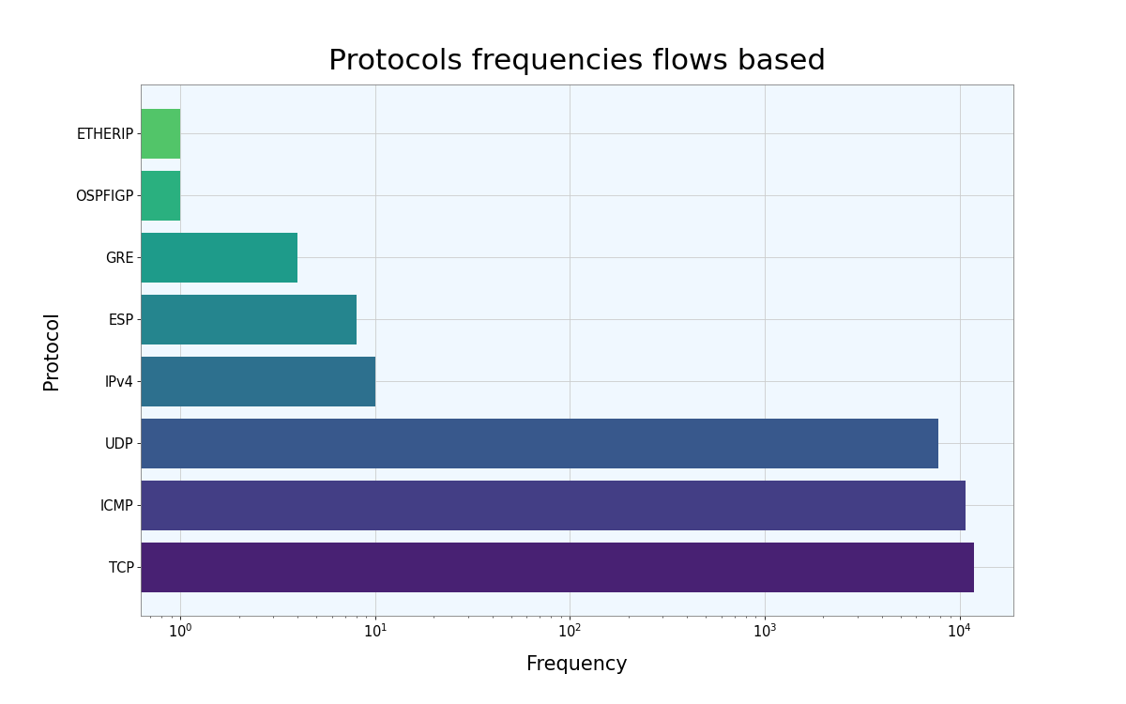
Protocols mostly used
In our trace have been used only 8 protocols.

Slide 13
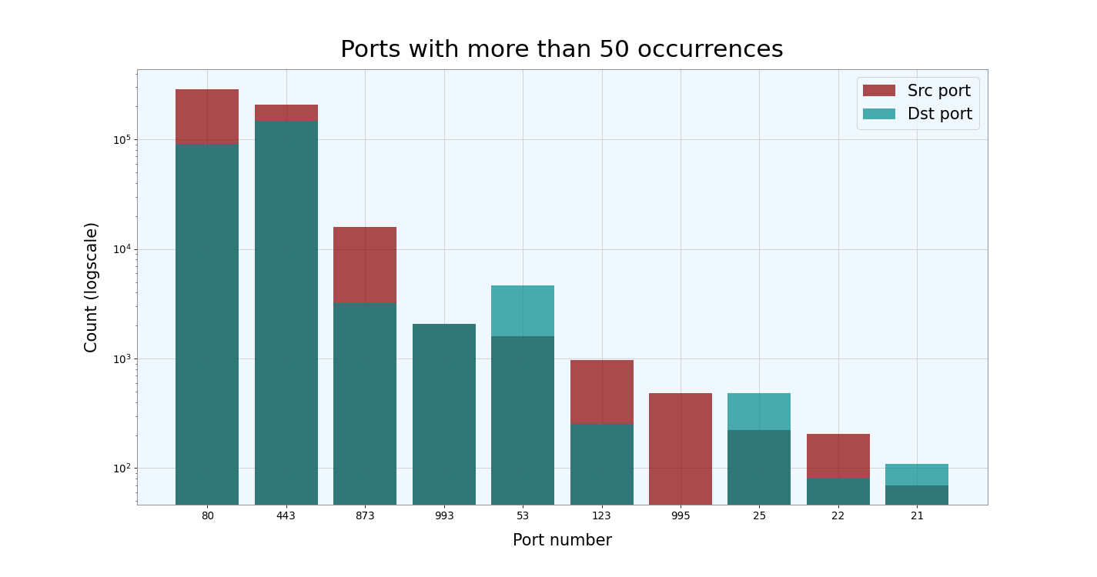
Port Scanner evaluation
10 Ports mostly used

Slide 14
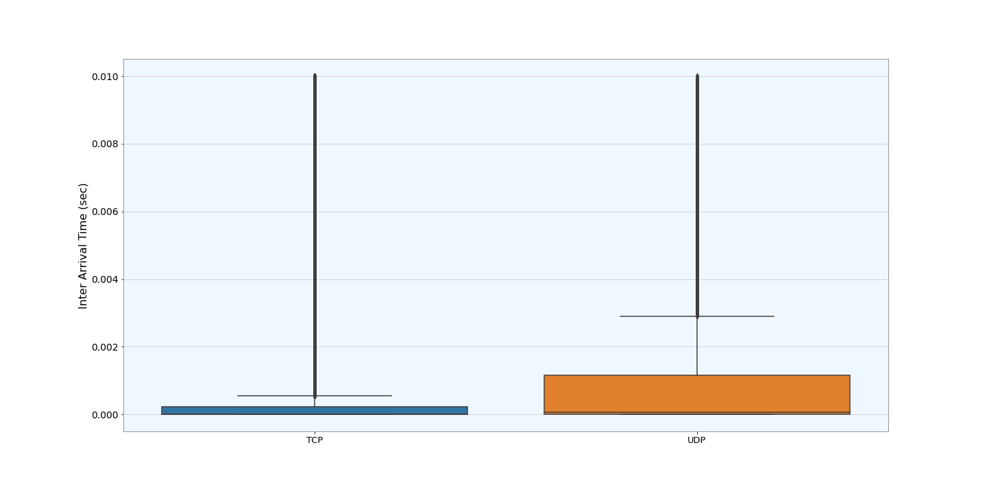
InterArrival time boxplot between TCP and UDP sessions

Slide 15
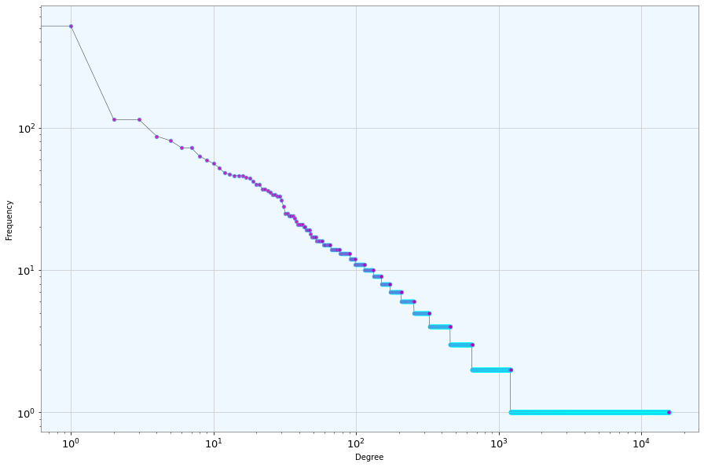
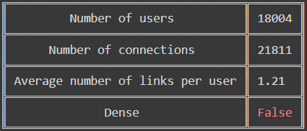
Topology of the network

Slide 16
Centrality measures
Pagerank
Betweenness
1 | 203.122.146.18
2 | 203.122.128.169
3 | 202.239.228.38
4 | 202.7.174.242
5 | 150.57.136.251
1 | 203.122.146.18
2 | 202.7.174.242
3 | 202.239.228.38
4 | 202.9.53.195
5 | 150.57.104.202

Slide 17
Centrality measures
Degree centrality
Closeness centrality
1 | 203.122.146.18
2 | 203.122.128.169
3 | 202.239.228.38
4 | 202.7.174.242
5 | 150.57.136.251
1 | 203.122.146.18
2 | 185.32.16.30
3 | 14.96.80.105
4 | 210.140.235.203
5 | 58.82.221.186

Slide 18
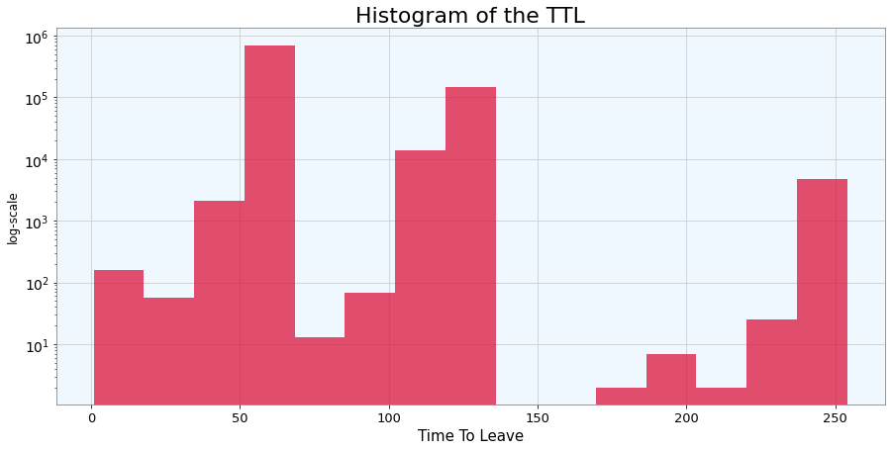
Time To Leave evaluation

Slide 19
Time To Leave evaluation
Minimum | 1
Maximum | 254
Mean | 70.328
1st quartile | 56
Median | 57
3rd quartile | 60

Slide 20
Part B - Unsupervised learning

Slide 21
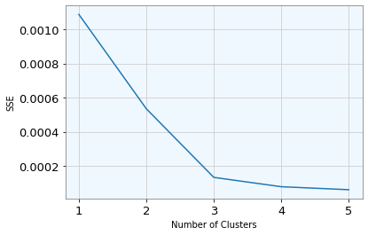
Unsupervised learning
The idea was to classify the top 4 mostly used protocols (TCP, ECMP, UDP and IPv4) with the K-Means algorithm.
Firstly, we performed a dimensionality reduction on the dataset with a PCA and we considered only the first two principal components which explained the 99% of the total variance.
Looking at the elbow method plot, the optimal number of clusters is equal to 3, even if we have considered 4 protocols.

Slide 22
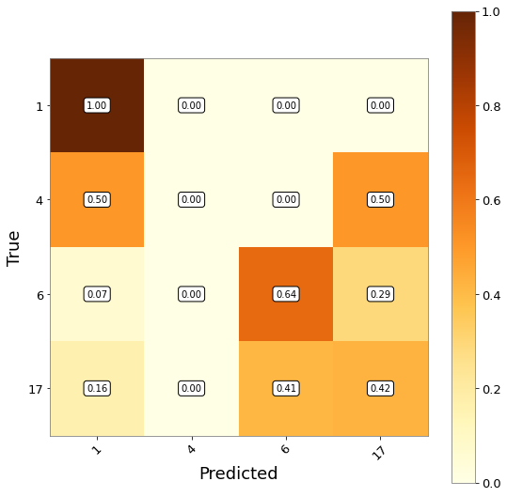
Confusion matrix
Legend
1: ICMP
4: IPv4
6: TCP
17: UDP
We noticed that samples from IPv4 are equally assigned to ICMP and UDP, while in general the most misclassified is UDP for which just the 42% is correctly assigned.

Slide 23
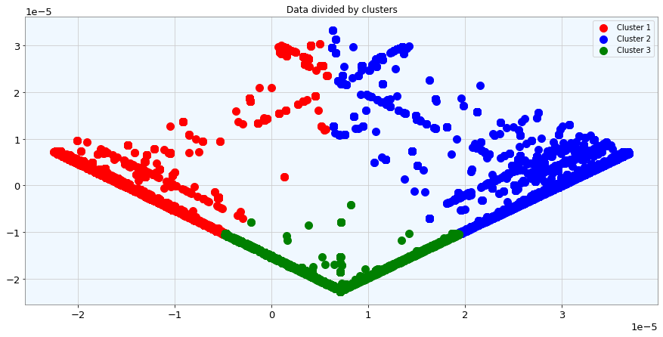
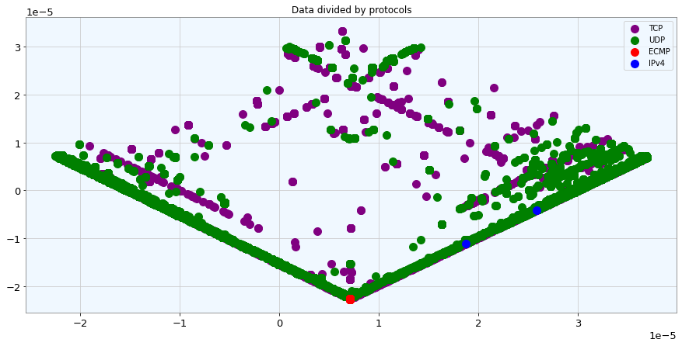
Comparison between the plot of the obtained clusters and the original protocols

